Slide 1
Chicago Covid-19 Case analysis

Slide 2
Overview
Chicago covid-19 data is spread over the years 2020, 2021 and 2022 consisting of 7,320 case records and 21 fields.
This data has been sourced from Chicago data portal.

Slide 3
Objective
Analyse covid-19 data for Illinois to generate insights and identify trends on the evolving pandemic over the years.
Explore positivity rate, death rate, highest weekly case rate and death rate neighbourhoods, cumulative case rates.

Slide 4
Methodology
Data pre-processing and manipulation is done using Python and insights drawn using Tableau.

Slide 5
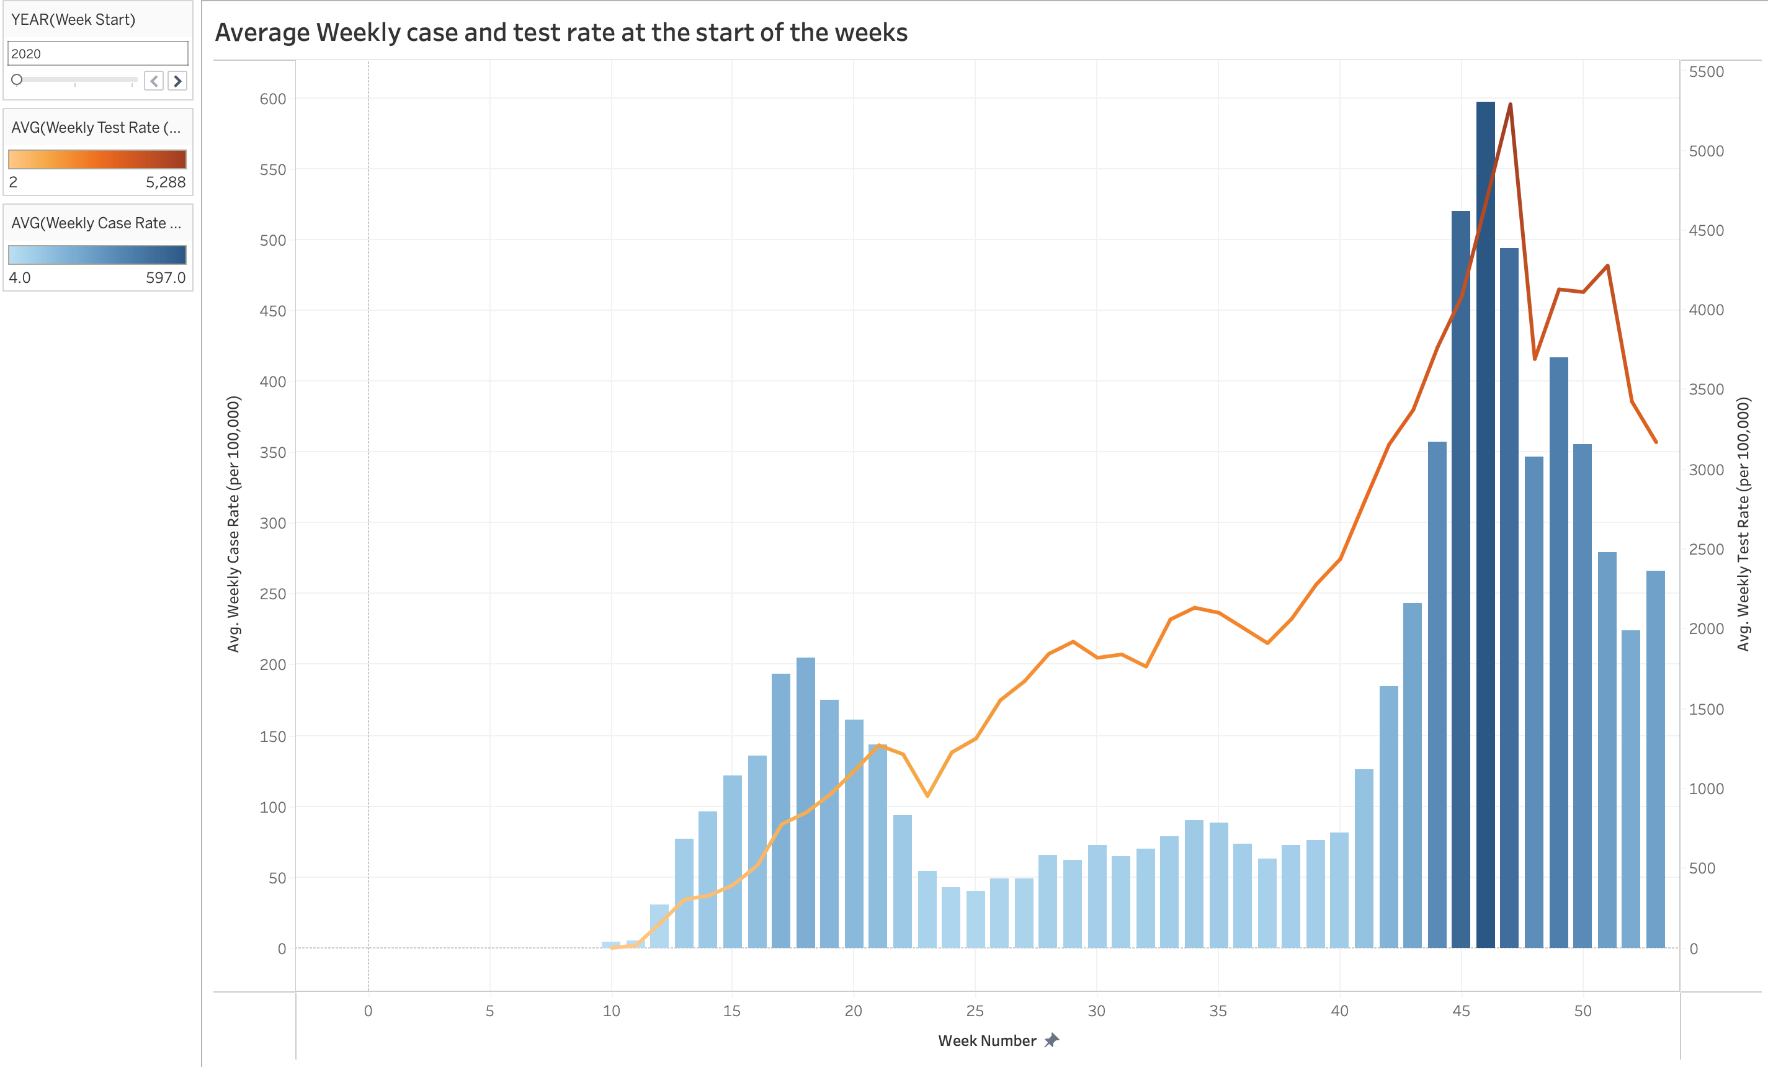
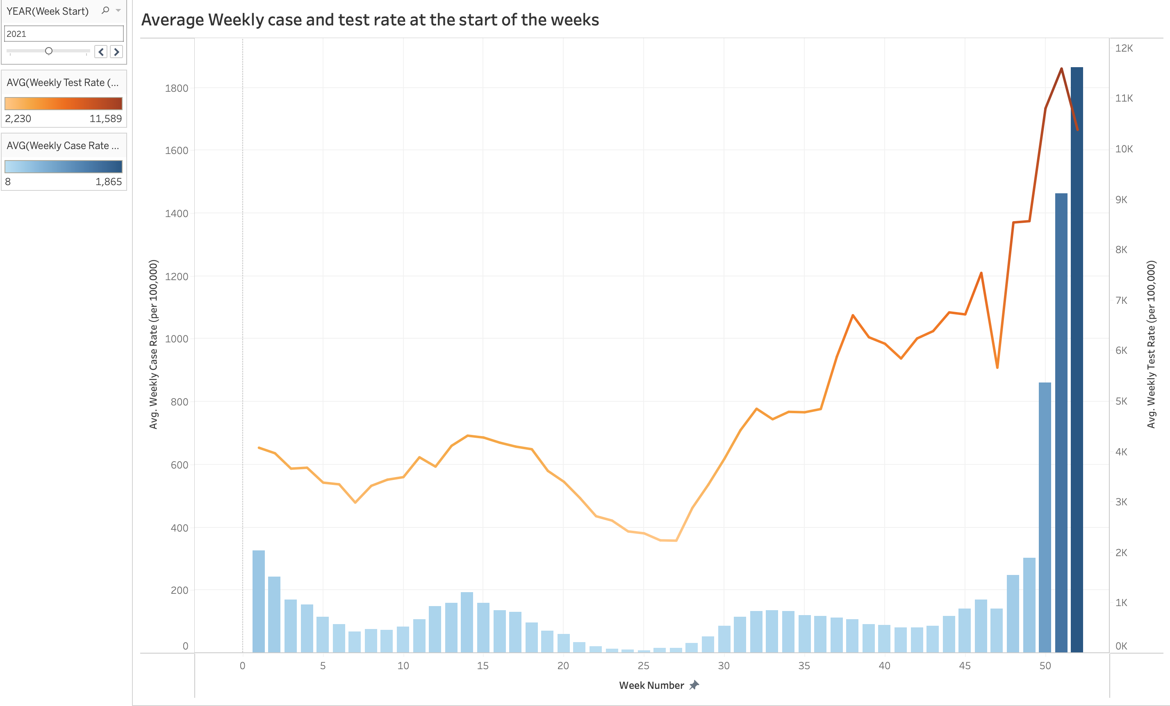
Results
Dual axis bar and line chart portraying Average weekly case and test rate for weekdays. Axis to the left shows Average weekly case rate (per 100,000), axis to the right shows the Average weekly test rate (per 100,000) in a line chart and
X – axes shows the week number.
Bar chart to the left represents year 2020 and the one on the right represents year 2021.
NOTE : Scales vary for left and right axes in both charts.

Slide 6
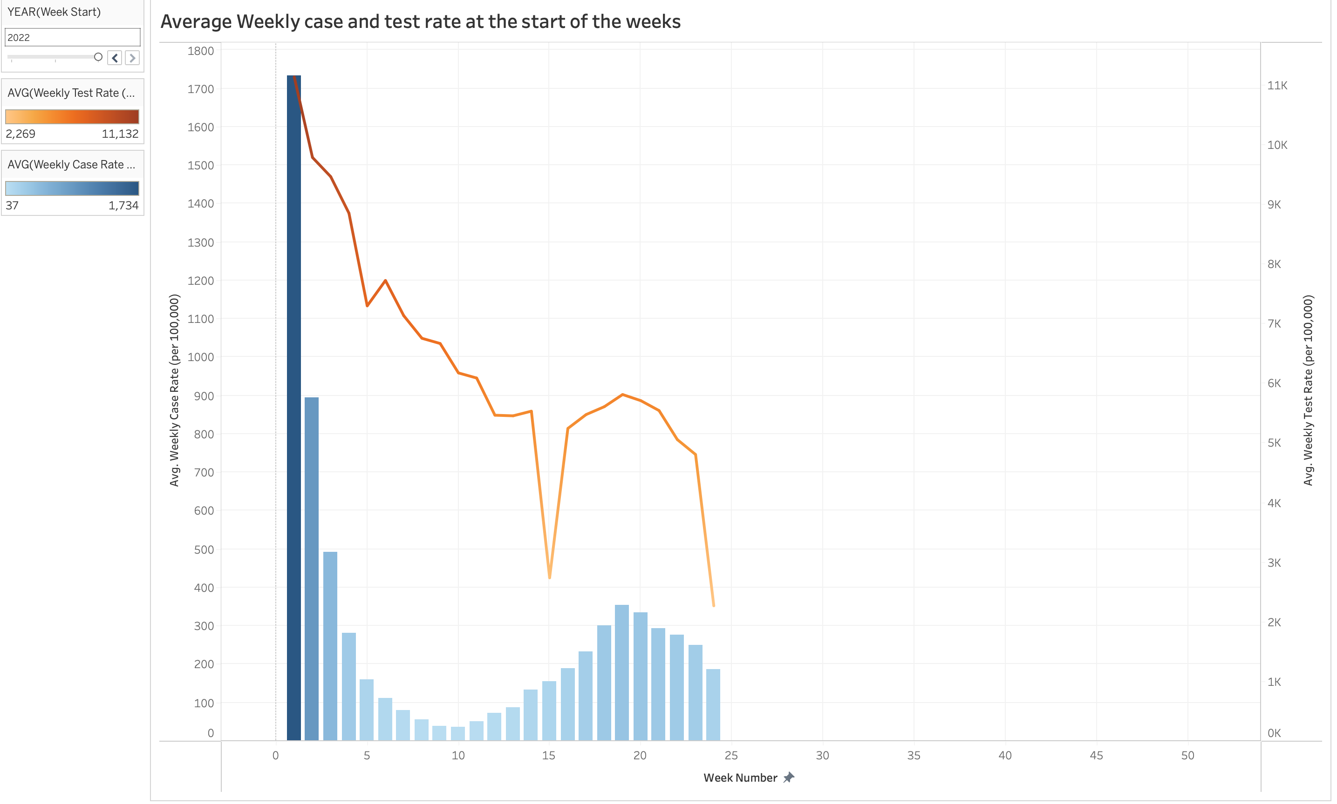
Dual axis bar chart representing Average case and test rate for the year 2022. Axis to the left shows Average weekly case rate (per 100,000), axis to the right shows the Average weekly test rate (per 100,000) in a line chart and X – axis shows the week number.
In year 2020, case rates increase along with test rate. Weeks 43-46 witnesses, highest case rate and test rate. Highest during winter season for the year.
In year 2021, case rates were lower most of the year. However, weeks 50 – 52 witnesses drastic spike in positive cases which coincidentally during winter season. Test rate remained high the entire year.
In year 2022, highest case rate has been recorded in the first week of the year along with an equivalent test rate.
NOTE : Scales vary between two axes.

Slide 7
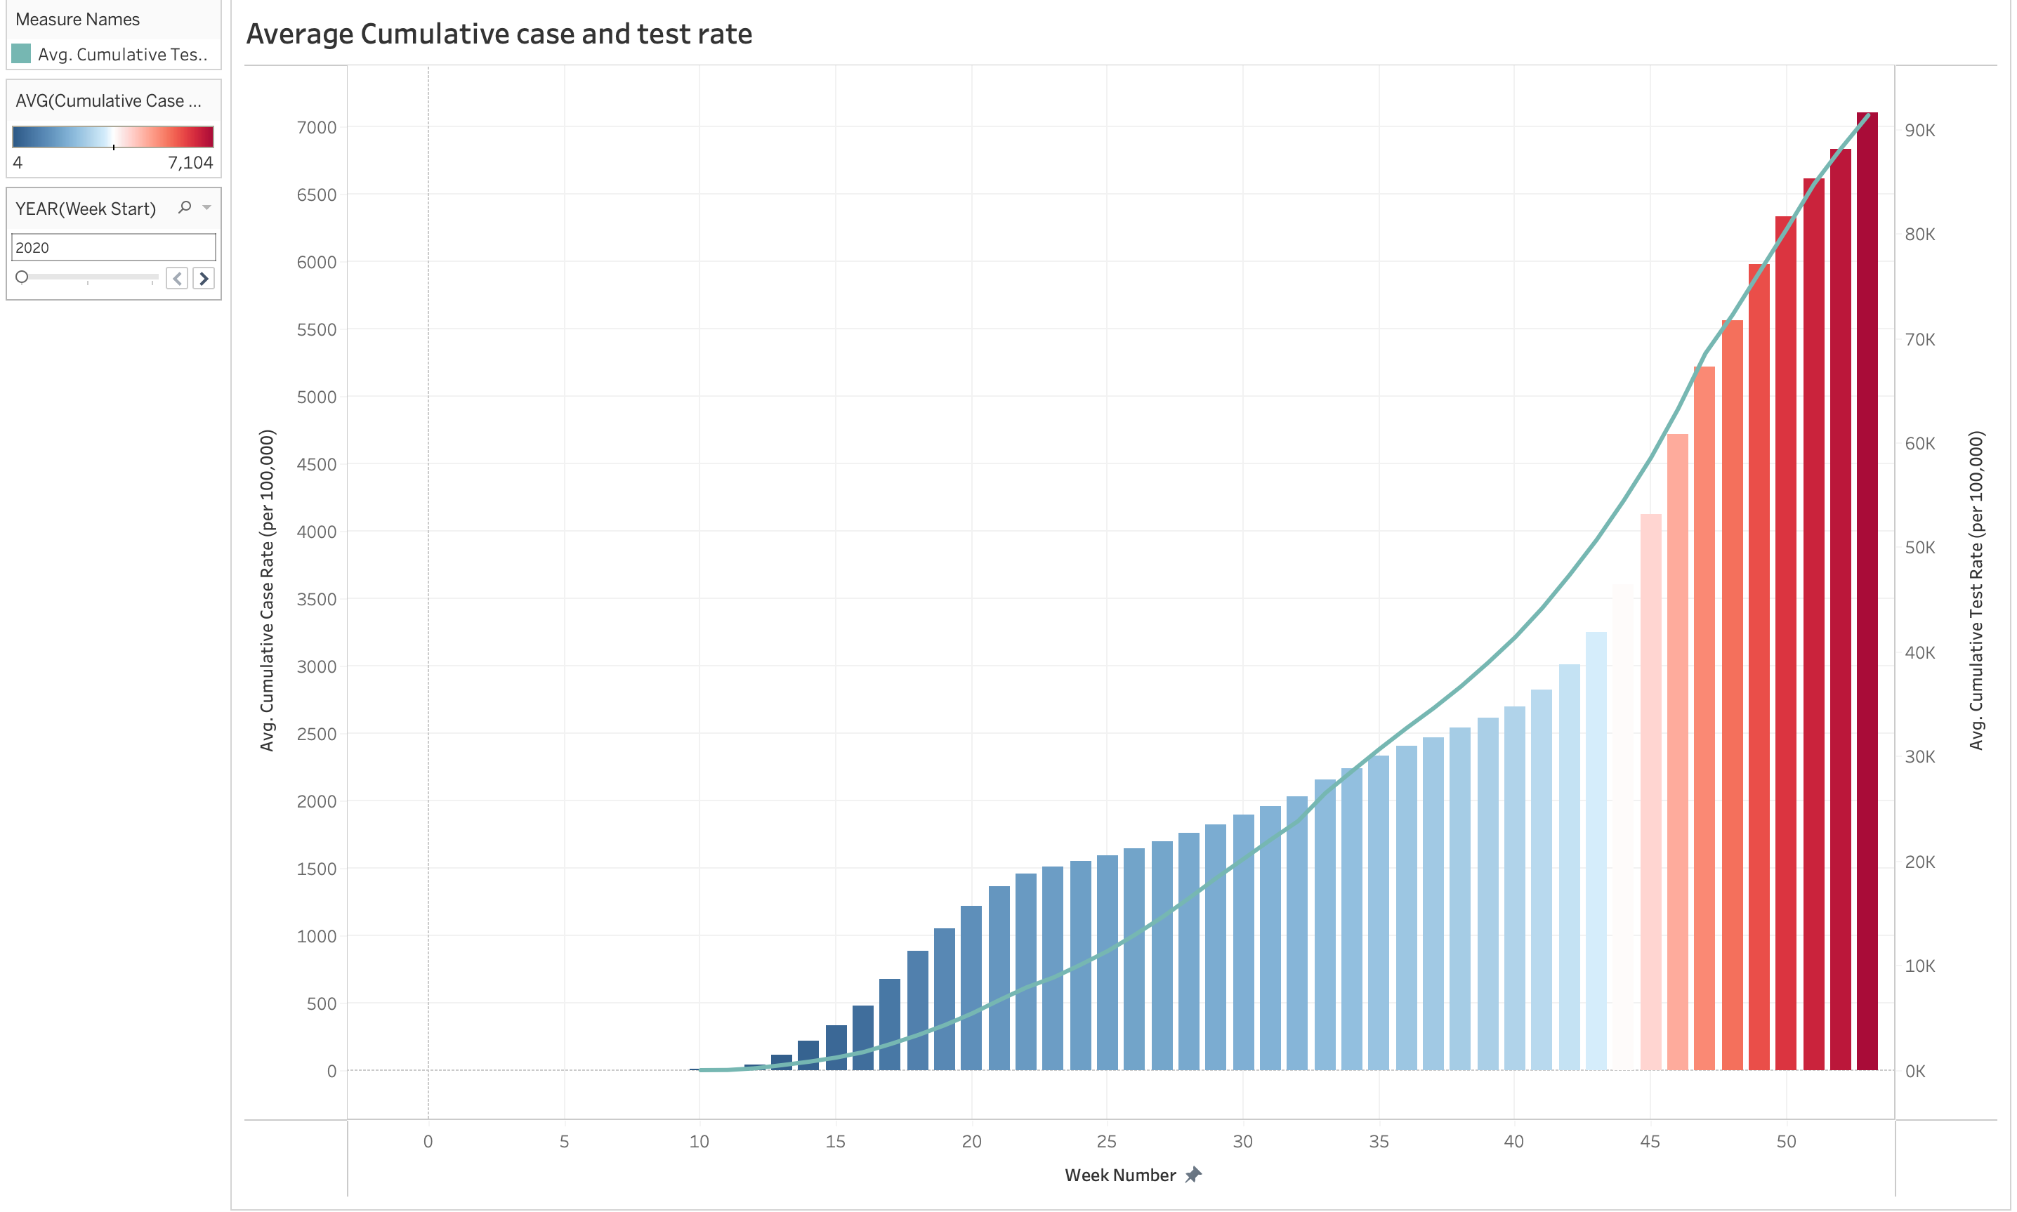
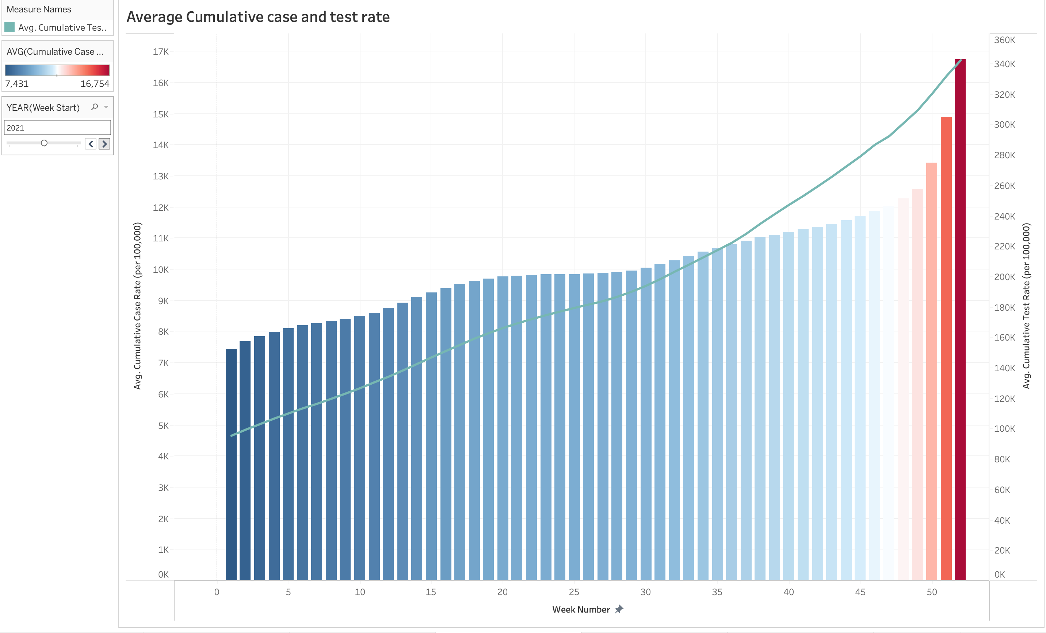
Dual axis bar and line chart portraying Average cumulative case and test rate. Axis to the left shows Average Cumulative case rate (per 100,000), axis to the right shows the Average Cumulative test rate (per 100,000) in a line chart and X – axis shows the week number.
Bar chart to the left represents year 2020 and the one on the right represents year 2021.
NOTE : Scales vary for left and right axis in both charts.

Slide 8
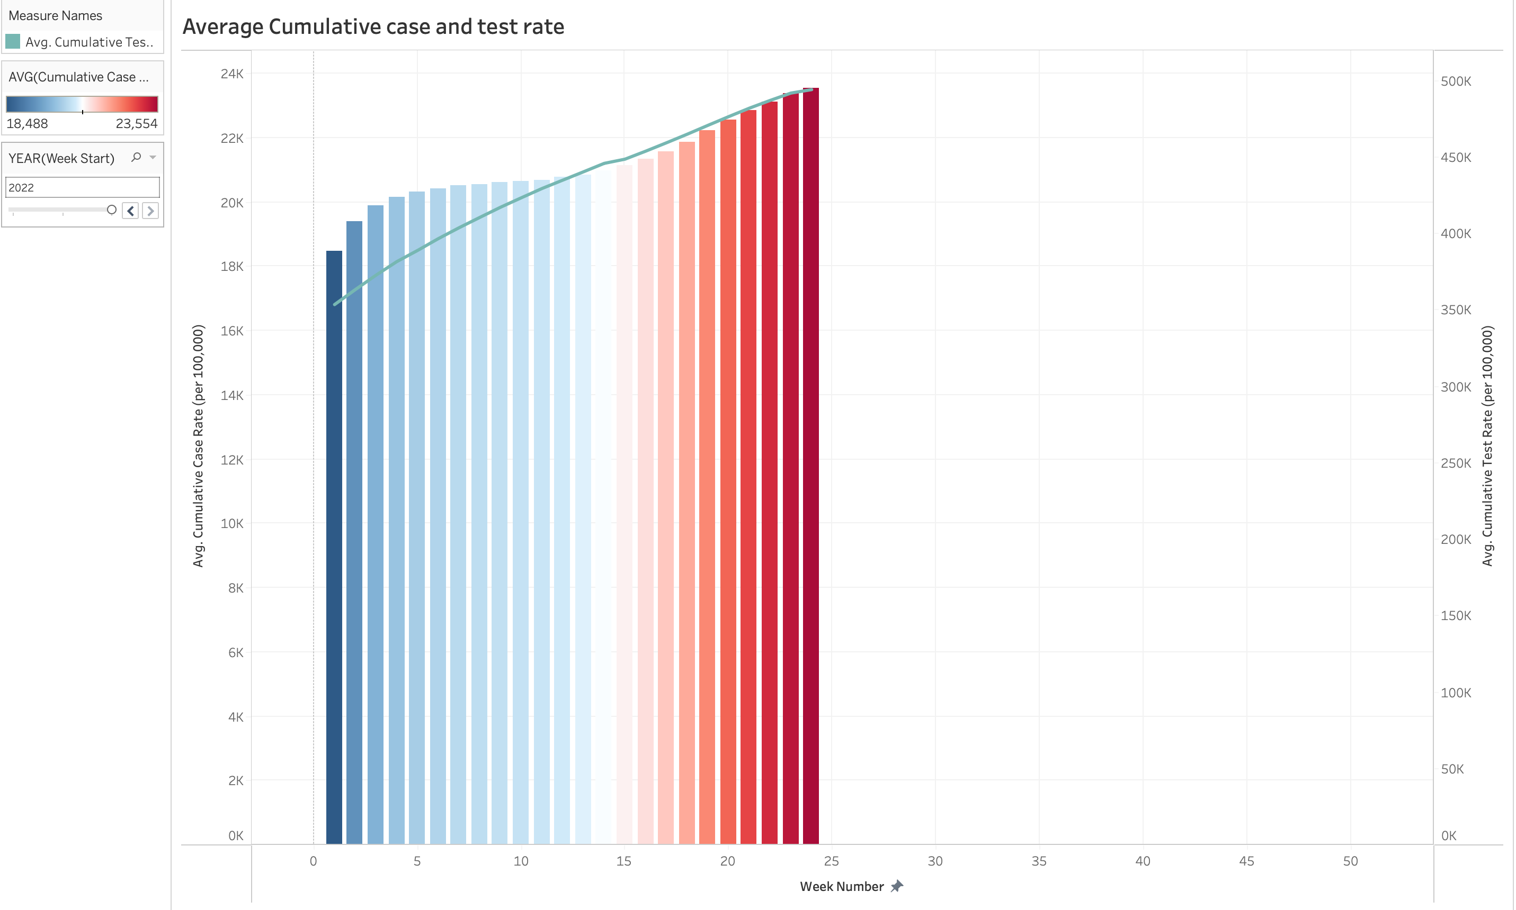
Dual axis bar chart represents Average cumulative and test rate for year 2022. Axis to the left shows Average weekly case rate (per 100,000), axis to the right shows the Average cumulative test rate (per 100,000) in a line chart and X – axes shows the week number.
NOTE : Scales vary for left and right axes.

Slide 9
Cumulative case rate increases with an equivalent increase in test rate over the weeks every year.
In year 2020, weeks 43 – 53 witnesses its highest peak. Case rates range between 5000 – 7000.
In year 2021, weeks 47 – 52 witnesses its highest peak. Case rates range between 11k – 16k.
In year 2022, weeks 15 – 24 has witnessed its all time peak. Case rates range between 21k – 23k.

Slide 10
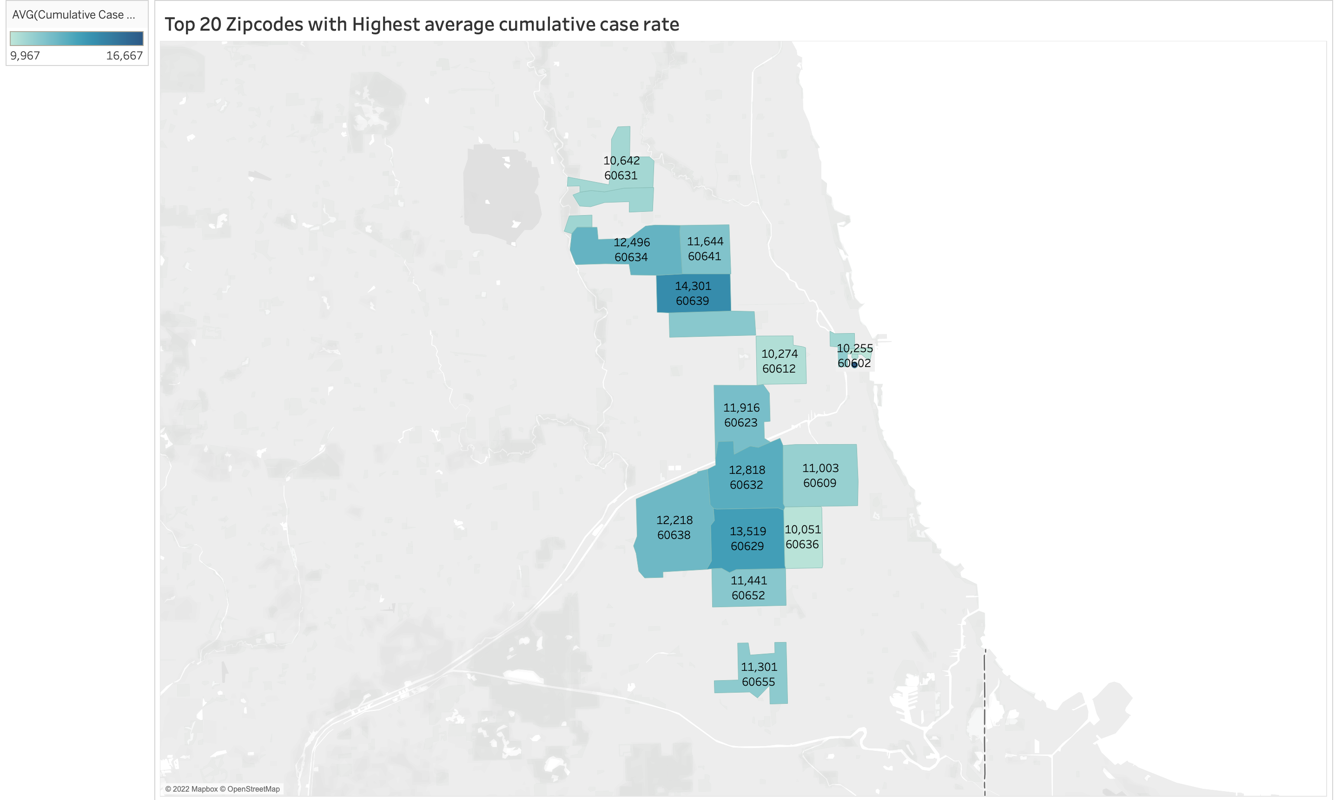
Illinois map exhibiting the Top - 20 zip codes with highest positivity percent.
Zip codes 60639, 60629, 60634 were the three major neighbourhoods with record levels of average cumulative case rate (per 100,000).

Slide 11
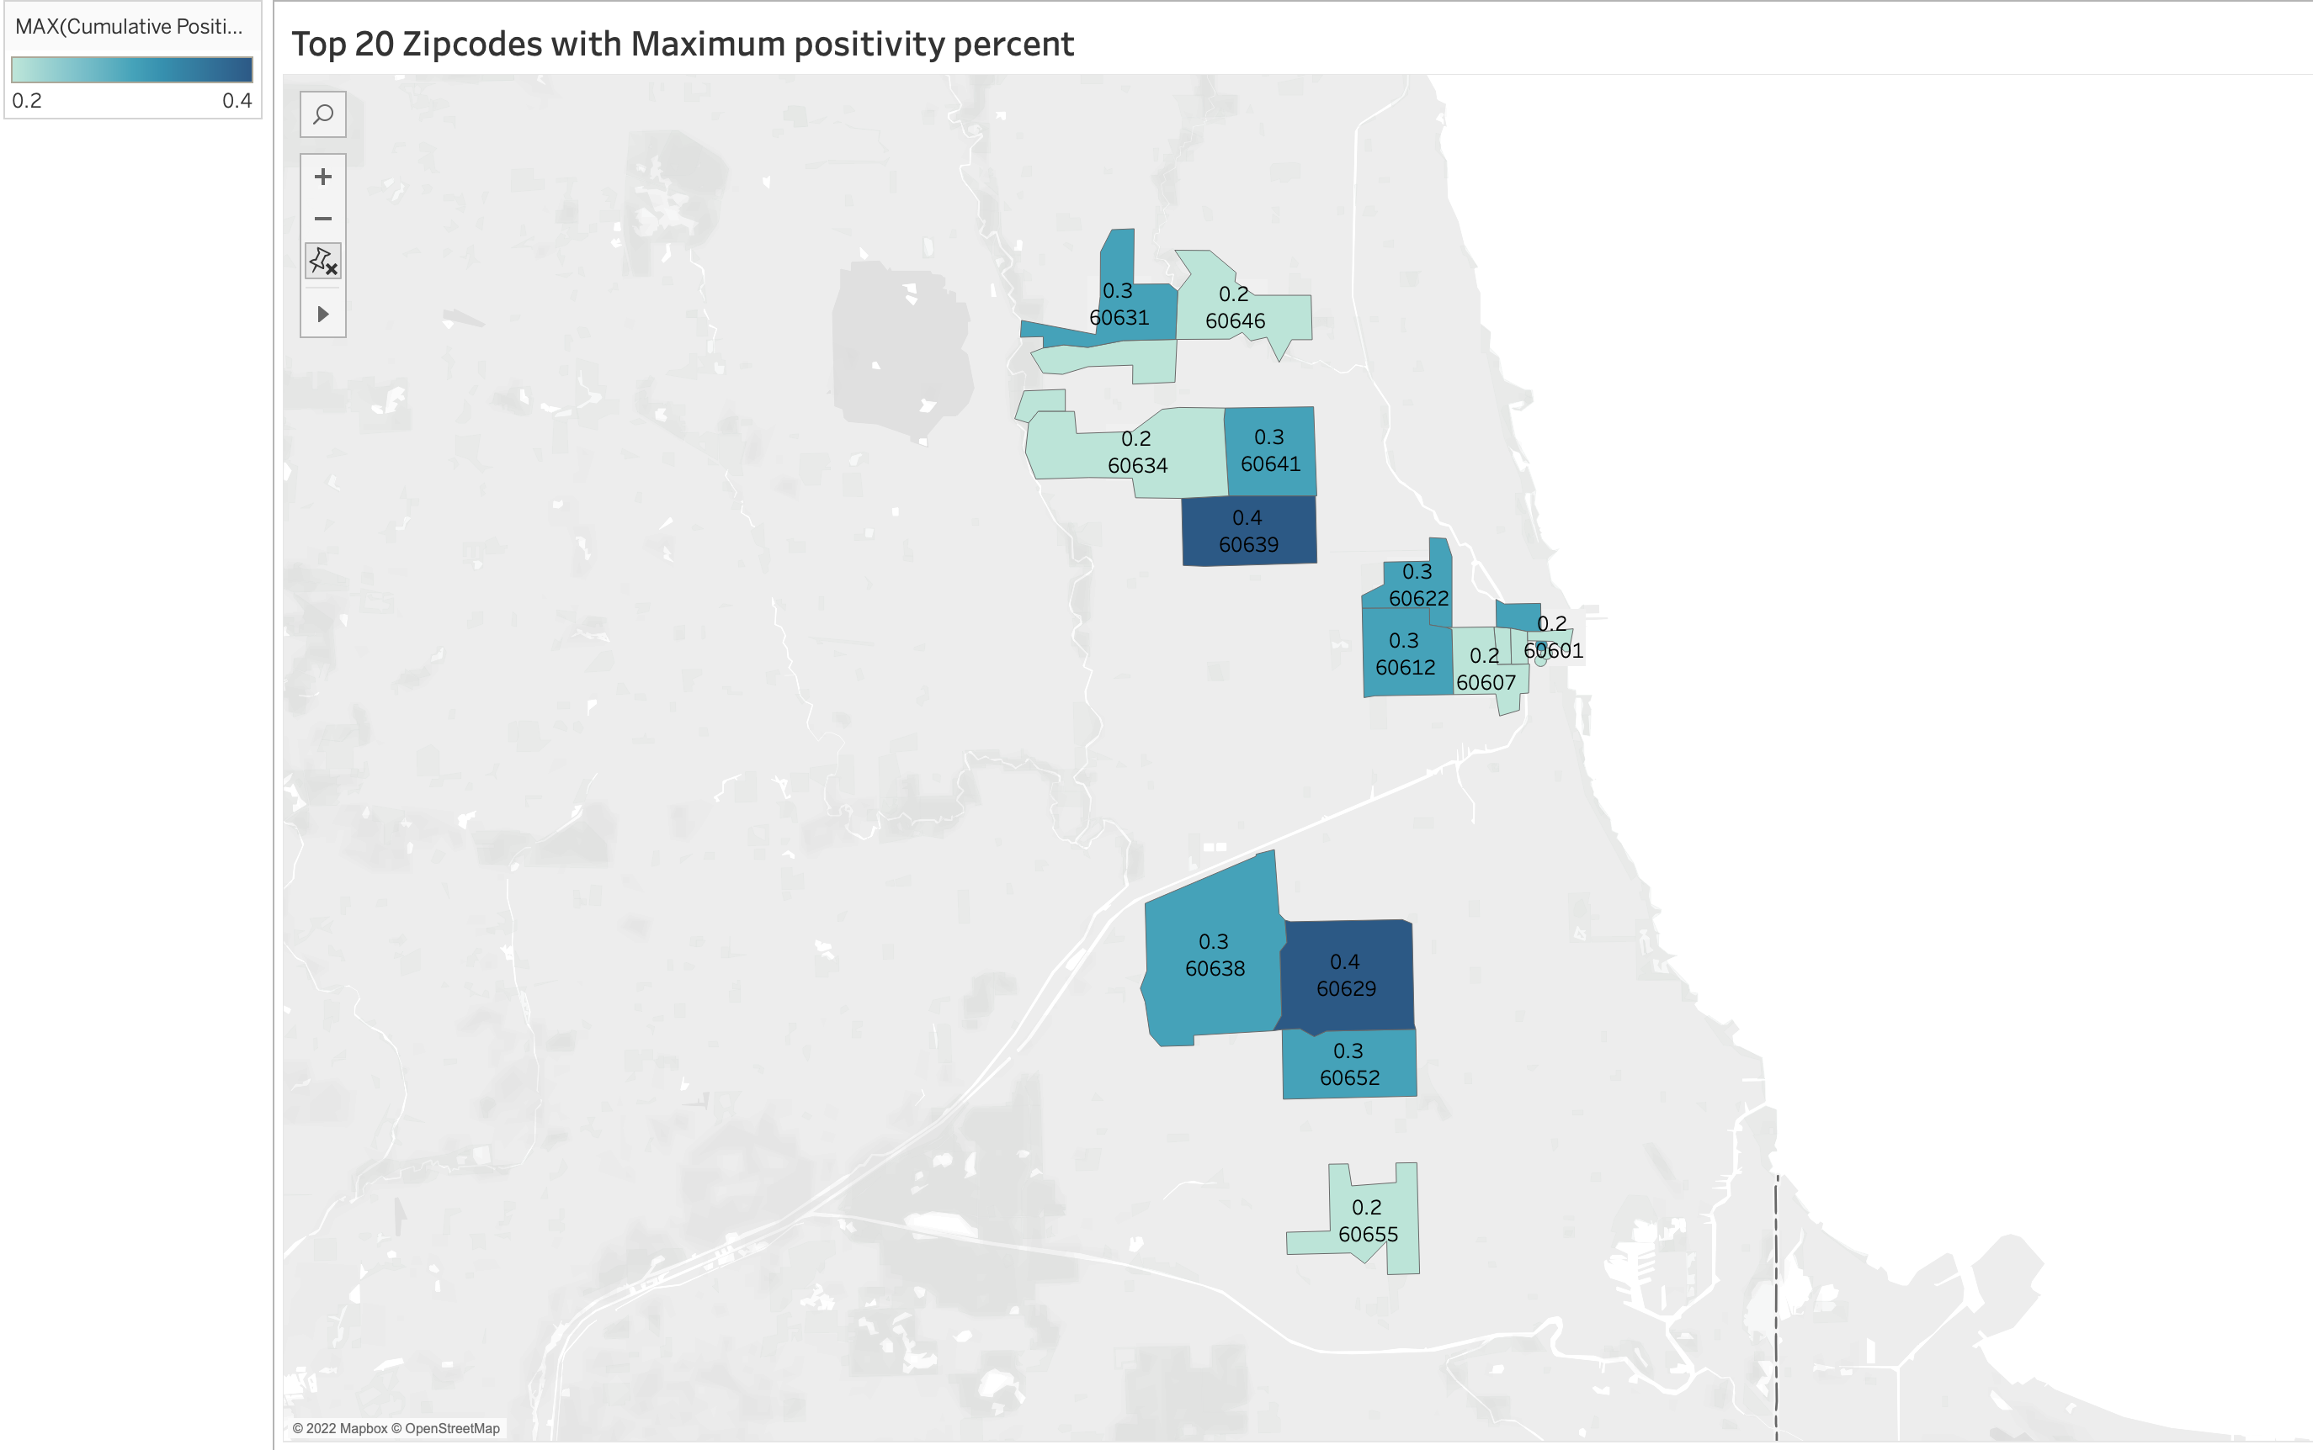
Illinois map exhibiting the Top - 20 zip codes with highest positivity percent.
Zip codes 60629, 60639 were the two major neighbourhoods with a soaring positivity percent of 0.4 .

Slide 12
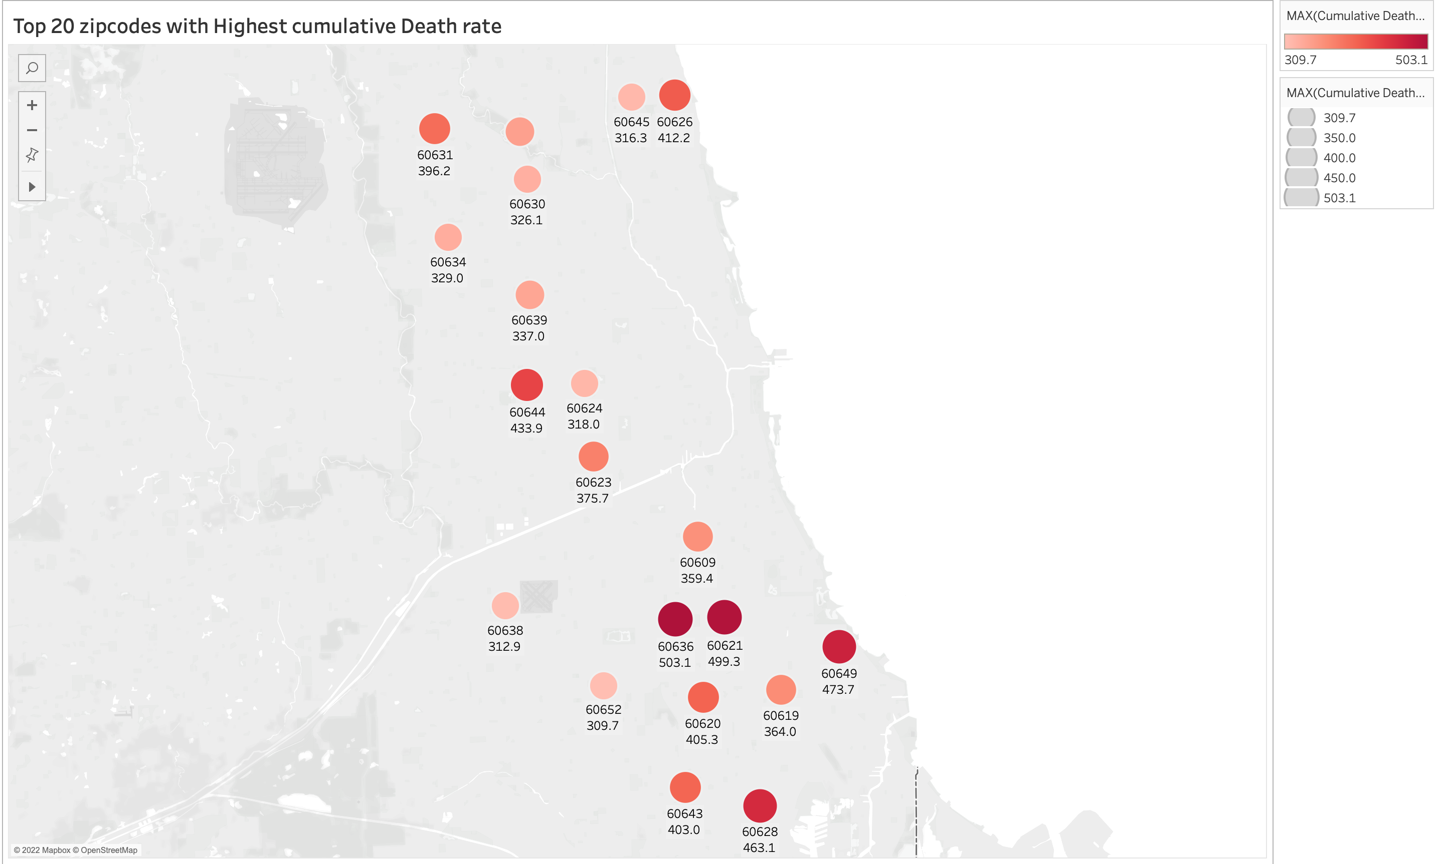
Illinois map that represents the Top - 20 zip codes with having highest death rate of all the others.
Zip codes 60636, 60621 and 60649 have the highest cumulative death rate per (100,000).

Slide 13
Conclusion
Years 2020 and 2021 experience their peak case rate during winter. However, during 2022 all time peak is experienced in the middle of the year during spring which is an alarming signal.
There is little or no evidence that high positivity rate leads to high death rate.
Sufficient evidence can be found between high positivity rate which leads to high case rate.

